Slide 1
Basics of C
Session 1

Slide 2
Objectives
Differentiate between Command, Program and Software
Explain the beginning of C
Explain when and why is C used
Discuss the C program structure
Discuss algorithms
Draw flowcharts
List the symbols used in flowcharts

Slide 3
Software, Program and Command
Software
Program 1
Program 2
Commands
Commands
Commands

Slide 4

The Beginning of C
BPCL – Martin Richards
B – Ken Thompson
C – Dennis Ritchie

Slide 5
Application Areas Of C
C was initially used for systems programming
A system program forms a portion of the operating
system of the computer or its support utilities
Operating Systems, Interpreters, Editors, Assembly
programs are usually called system programs
The UNIX operating system was developed using C
There are C compilers available for almost all types
of PC’s

Slide 6
Middle Level Language
High Level Language
C
Assembly Language

Slide 7
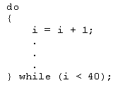
Structured Language
C allows compartmentalization of code and data
It refers to the ability to section
off and hide all information and
instructions, necessary to
perform a specific task, from the
rest of the program
Code can be compartmentalized in C by using
functions or code blocks.

Slide 8
About C
C has 32 keywords
These keywords combined with a formal syntax
form a C programming language
Rules to be followed for all programs written in C:
All keywords are lowercased
main()
{
/* This is a sample Program*/
int i,j;
i=100;
j=200;
:
}
C is case sensitive, do while is different from DO WHILE
Keywords cannot be used as a variable or function name

Slide 9
The C Program Structure-1
main()

Slide 10
The C Program Structure-2
Delimiters { ... }

Slide 11
The C Program Structure-3
Statement Terminator .... ;

Slide 12
The C Program Structure-4
/* Comment Lines */

Slide 13
The C Library
All C compilers come with a standard
library of functions
A function written by a programmer
can be placed in the library and used
when required
Some compilers allow functions to
be added in the standard library
Some compilers require a separate
library to be created

Slide 14
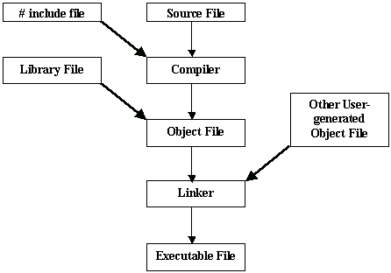
Compiling & Running A Program

Slide 15




The Programming Approach to Solving Problems
Classroom
Algorithm is a set of steps that are performed to solve a problem. The example below describes an algorithm
Leaving the
classroom
Head towards
the staircase
Go to the
basement
Head for the
cafeteria
These are the steps followed when a student wants to go to the cafeteria from the classroom
Cafeteria

Slide 16
Solving a Problem
In order to solve a problem
Understand the problem clearly
Gather the relevant information
Process the information
Arrive at the solution

Slide 17
Pseudocode
It is not actual code. A method of algorithm - writing which uses a standard set of words which makes it resemble code
BEGIN
DISPLAY ‘Hello World !’
END
Each pseudocode starts with a BEGIN
To show some value , the word DISPLAY is used
The pseudocode finishes with an END

Slide 18
Flowcharts
It is a graphical representation of an algorithm
START
DISPLAY ‘Hello World !’
STOP

Slide 19
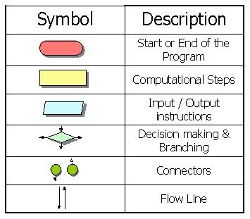
The Flowchart Symbol

Slide 20
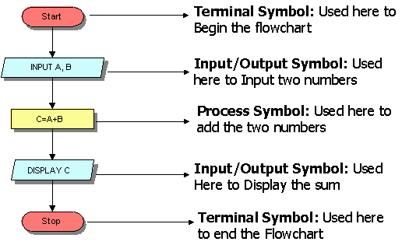
Flowchart to add two numbers

Slide 21
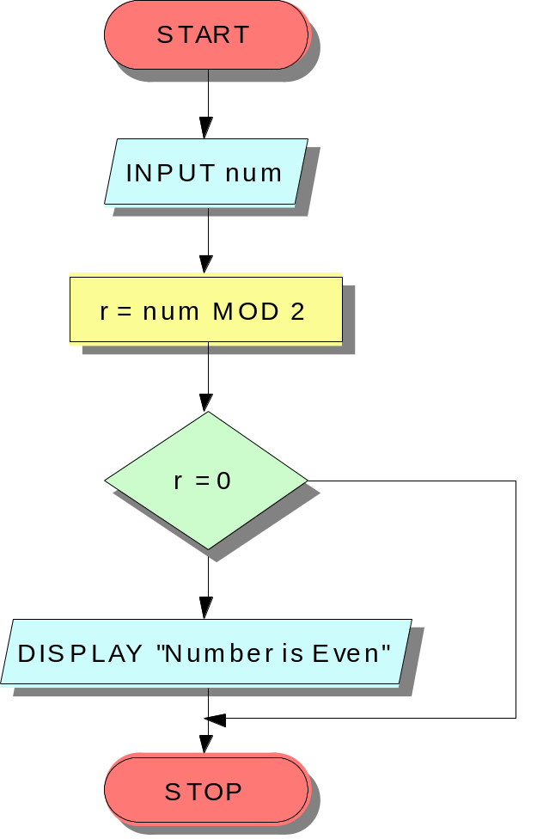
The IF Construct
BEGIN
INPUT num
r = num MOD 2
IF r=0
Display “Number is even”
END IF
END
No
Yes

Slide 22
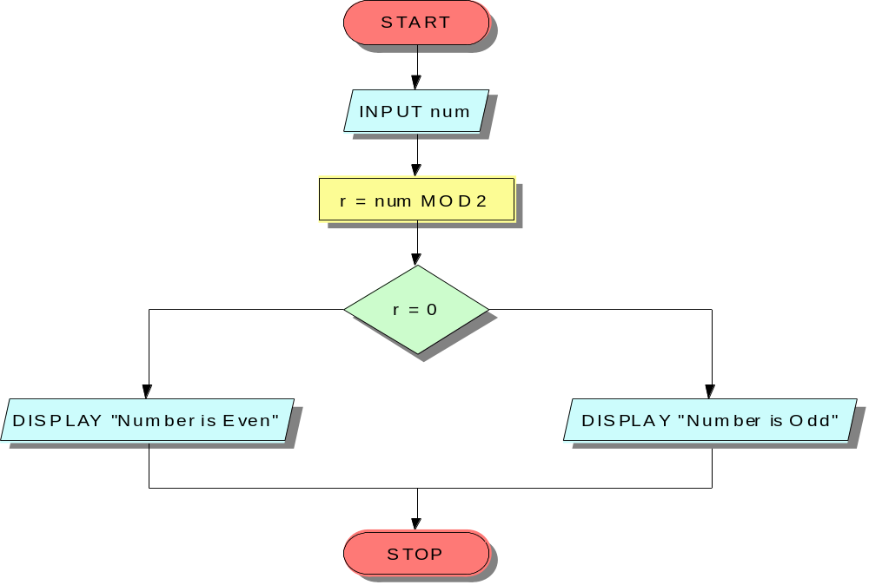
The IF-ELSE Construct
BEGIN
INPUT num
r=num MOD 2
IF r=0
DISPLAY “Even Number”
ELSE
DISPLAY “Odd Number”
END IF
END
Yes
No

Slide 23
Multiple criteria using AND/OR
BEGIN
INPUT yearsWithUs
INPUT bizDone
IF yearsWithUs >= 10 AND bizDone >=5000000
DISPLAY “Classified as an MVS”
ELSE
DISPLAY “A little more effort required!”
END IF
END

Slide 24
Nested IFs-1
BEGIN
INPUT yearsWithUs
INPUT bizDone
IF yearsWithUs >= 10
IF bizDone >=5000000
DISPLAY “Classified as an MVS”
ELSE
DISPLAY “A little more effort required!”
END IF
ELSE
DISPLAY “A little more effort required!”
END IF
END

Slide 25
Nested IFs-2
START
INPUT YearsWithUs
INPUT bizDone
YES
YearsWithUs >= 10
NO
DISPLAY “A Little more effort required”
NO
bizDone > 5000000
YES
DISPLAY “A Little more effort required”
DISPLAY “Classified as an MVS”
STOP

Slide 26
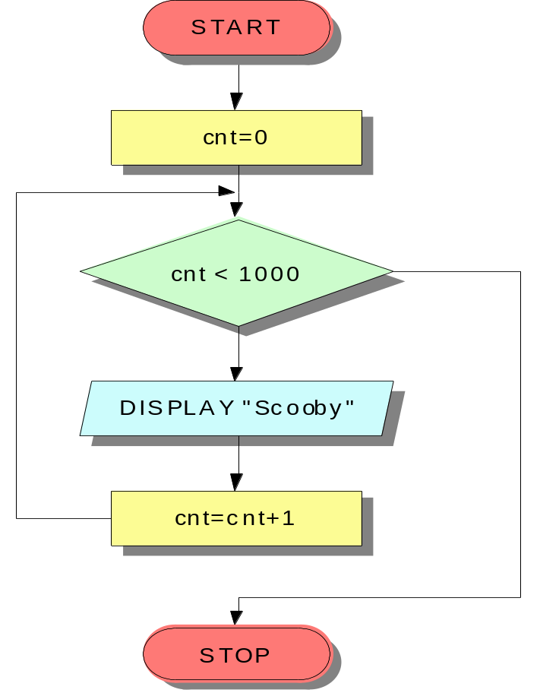
Loops
BEGIN
cnt=0
WHILE (cnt < 1000)
DO
DISPLAY “Scooby”
cnt=cnt+1
END DO
END
No
Yes

